Slide 1

Austin Transportation Department Signs Work Orders
Created By: Susanne Gov Created Date: 2020-05-21 Location Name: 7TH ST / PLEASANT VALLEY RD Intersection ID: 5161138 Cardinal Direction: N
Sign Type | Install/Remove
Left Turn Arrow Only | Install
Left Turn Yield Flashing Yellow | Install
Street Name Sign | Install
Straight Right Arrow | Install

Slide 2
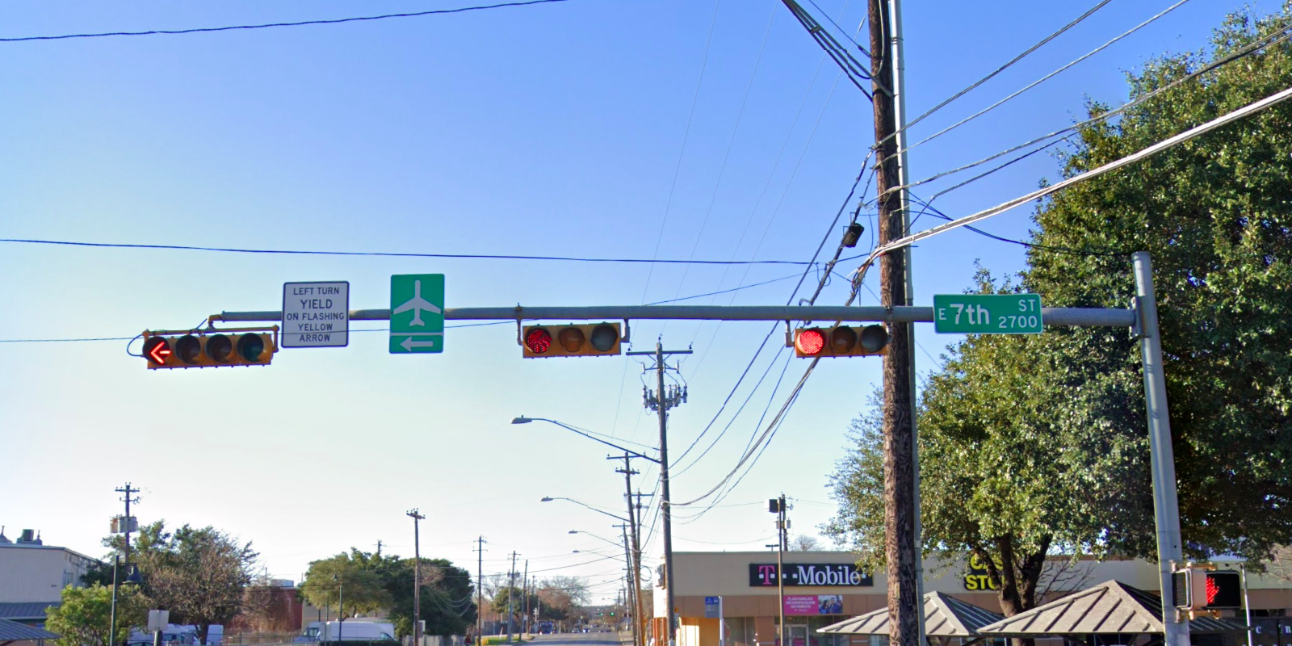
Austin Transportation Department Signs Work Orders
Created By: Susanne Gov Created Date: 2020-05-21 Location Name: 7TH ST / PLEASANT VALLEY RD Intersection ID: 5161138 Cardinal Direction: S
Sign Type | Install/Remove
Left Turn Yield Flashing Yellow | Install
Airport Symbol | Install
Street Name Sign | Install

Slide 3
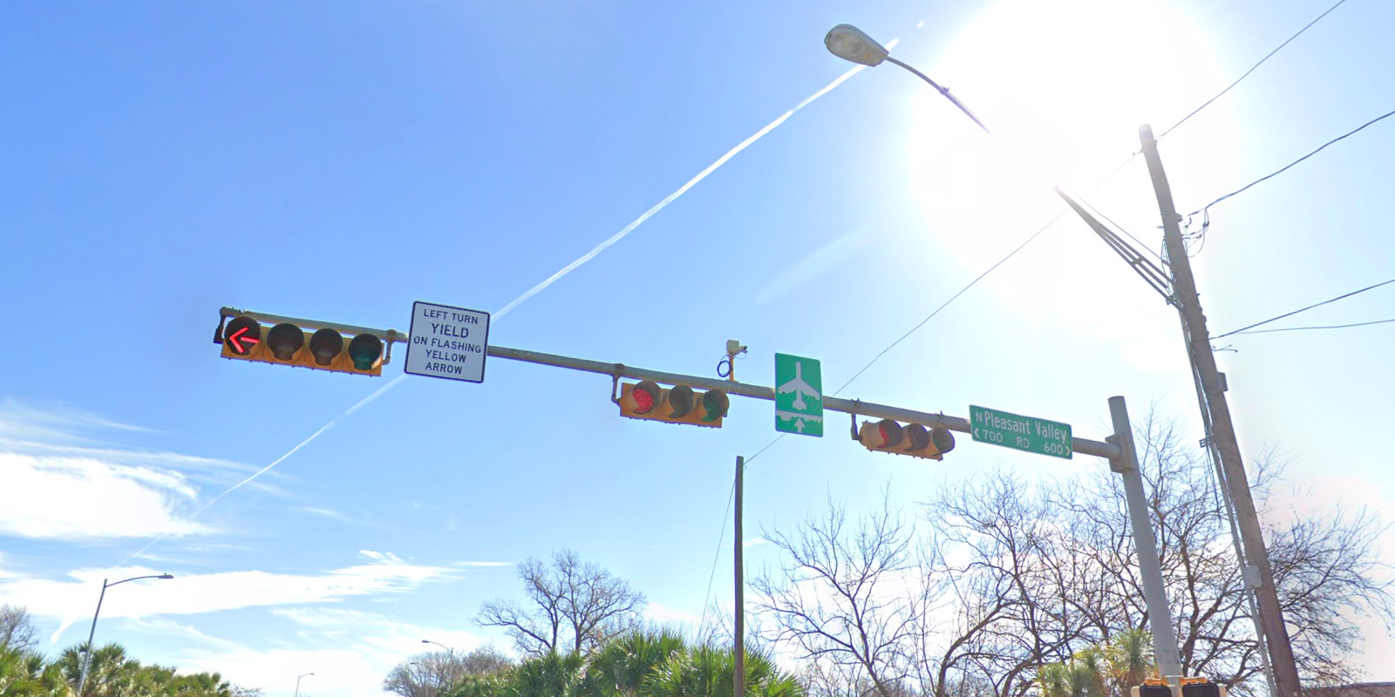
Austin Transportation Department Signs Work Orders
Created By: Susanne Gov Created Date: 2020-05-21 Location Name: 7TH ST / PLEASANT VALLEY RD Intersection ID: 5161138 Cardinal Direction: E
Sign Type | Install/Remove
Left Turn Yield Flashing Yellow | Install
Street Name Sign | Install
Airport Symbol | Install

Slide 4
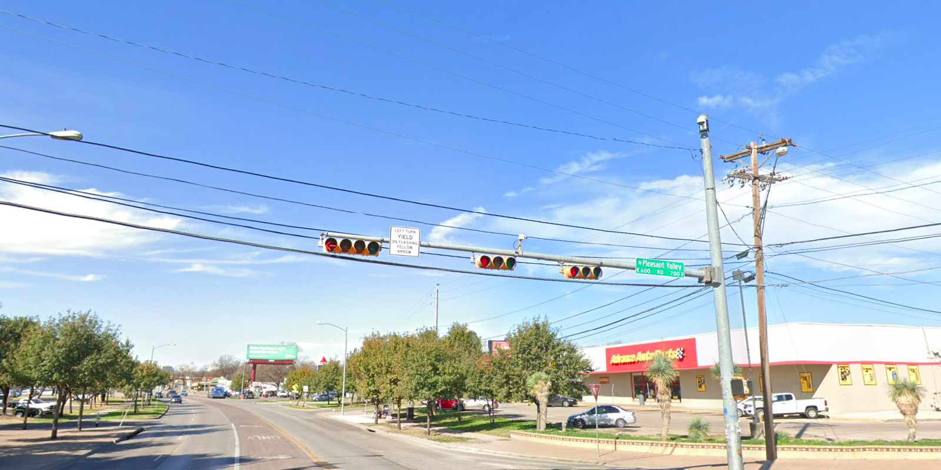
Austin Transportation Department Signs Work Orders
Created By: Susanne Gov Created Date: 2020-05-21 Location Name: 7TH ST / PLEASANT VALLEY RD Intersection ID: 5161138 Cardinal Direction: W
Sign Type | Install/Remove
Left Turn Yield Flashing Yellow | Install
Street Name Sign | Install

